Slide 1
Database Systems
AICT005-4-1-Database Systems (version1)
Week 10: SQL (Part 2)

Slide 2
Topic & Structure of The Lesson
Aggregate functions
Altering data type
Grouping data
Joining database

Slide 3
Learning Outcomes
At the end of this topic, You should be able to
Write SQL to manipulate database and joining database

Slide 4
Key Terms You Must Be Able To Use
If you have mastered this topic, you should be able to use the following terms correctly in your assignments and exams:
Alter
Modify
Drop
Group by
order by
JOIN

Slide 5
Advanced Data Definition Commands
All changes in table structure are made by using ALTER command
Followed by keyword that produces specific change
Following three options are available:
ADD
MODIFY
DROP

Slide 6
Changing a Column’s Data Type
ALTER can be used to change data type
Some RDBMSs (such as Oracle) do not permit changes to data types unless column to be changed is empty

Slide 7
Changing a Column’s Data Characteristics
Use ALTER to change data characteristics
If column to be changed already contains data, changes in column’s characteristics are permitted if those changes do not alter the data type

Slide 8
Adding a Column
Use ALTER to add column
Do not include the NOT NULL clause for new column

Slide 9
Dropping a Column
Use ALTER to drop column
Some RDBMSs impose restrictions on the deletion of an attribute

Slide 10
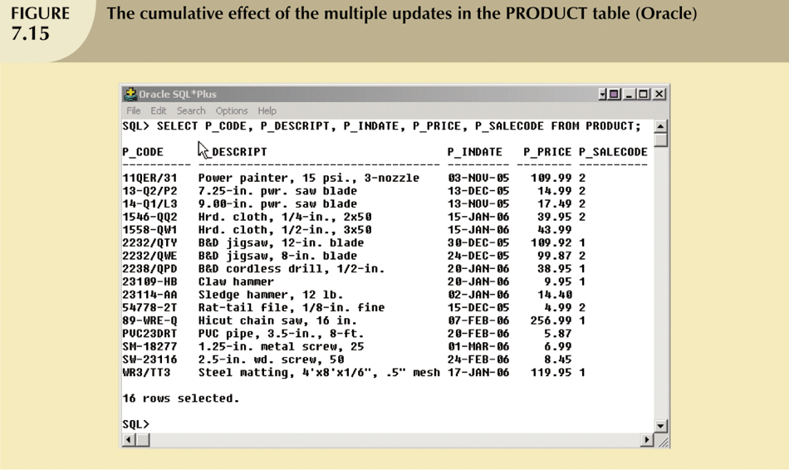
Advanced Data Updates

Slide 11
Copying Parts of Tables
SQL permits copying contents of selected table columns so that the data need not be reentered manually into newly created table(s)
First create the PART table structure
Next add rows to new PART table using PRODUCT table rows

Slide 12
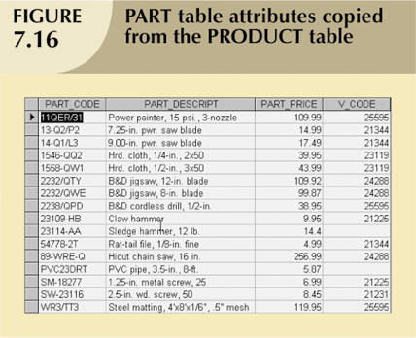
Copying Parts of Tables (continued)

Slide 13
Adding Primary and Foreign Key Designations
When table is copied, integrity rules do not copy, so primary and foreign keys need to be manually defined on new table
User ALTER TABLE command
Syntax:
ALTER TABLE tablename ADD PRIMARY KEY(fieldname);
For foreign key, use FOREIGN KEY in place of PRIMARY KEY

Slide 14
Deleting a Table from the Database
DROP
Deletes table from database
Syntax:
DROP TABLE tablename;

Slide 15
Advanced Select Queries
SQL provides useful functions that can:
Count
Find minimum and maximum values
Calculate averages
SQL allows user to limit queries to only those entries having no duplicates or entries whose duplicates may be grouped

Slide 16
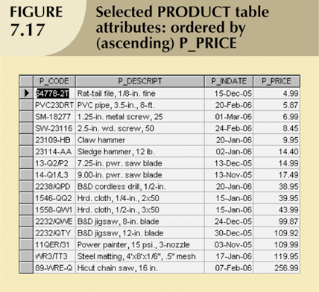
Ordering a Listing

Slide 17
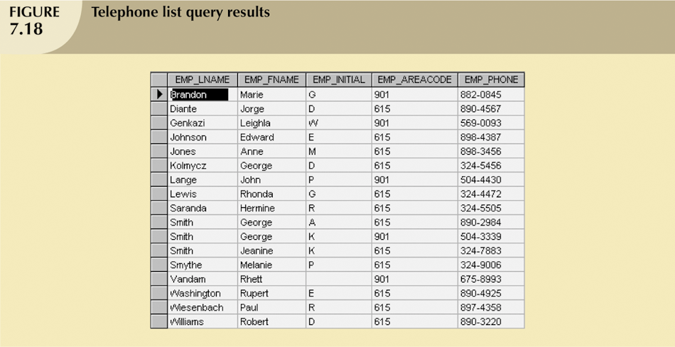
Ordering a Listing (continued)

Slide 18
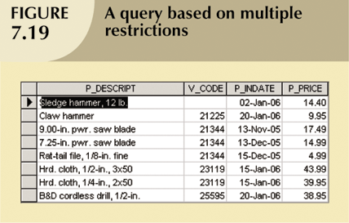
Ordering a Listing (continued)

Slide 19
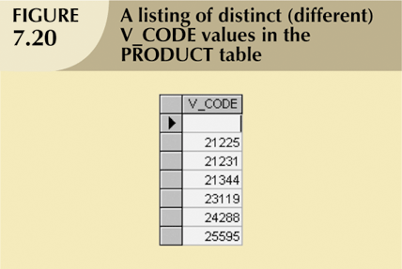
Listing Unique Values

Slide 20
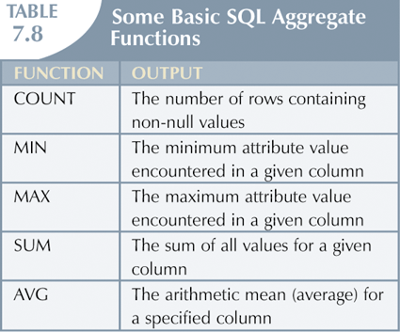
Aggregate Functions

Slide 21
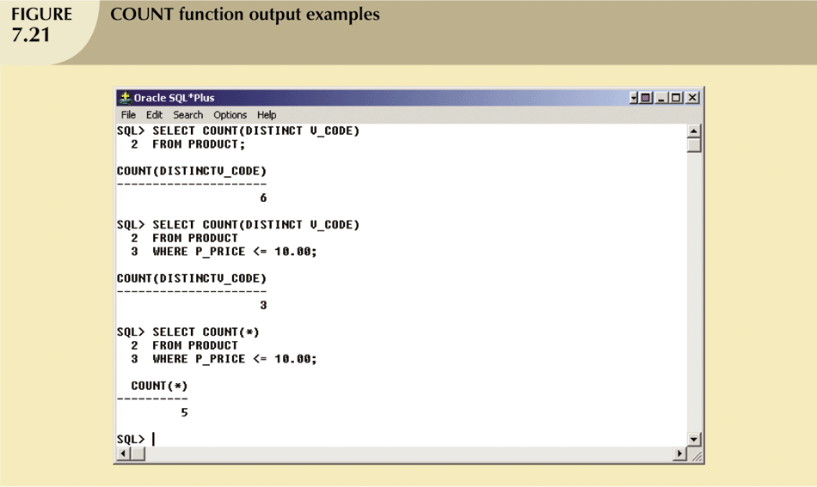
Aggregate Functions (continued)

Slide 22
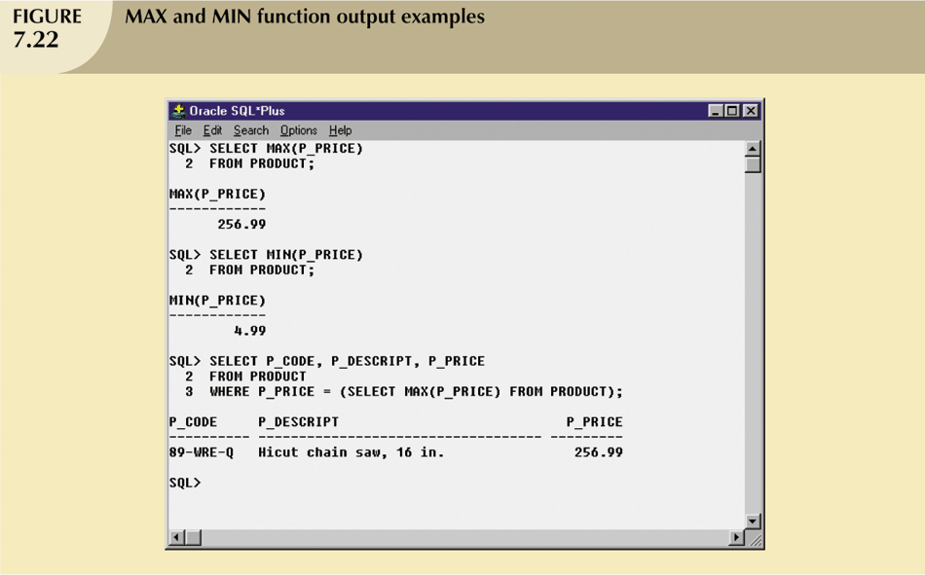
Aggregate Functions (continued)

Slide 23
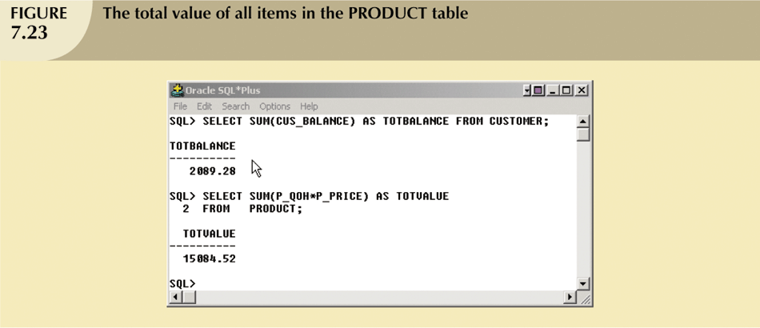
Aggregate Functions (continued)

Slide 24
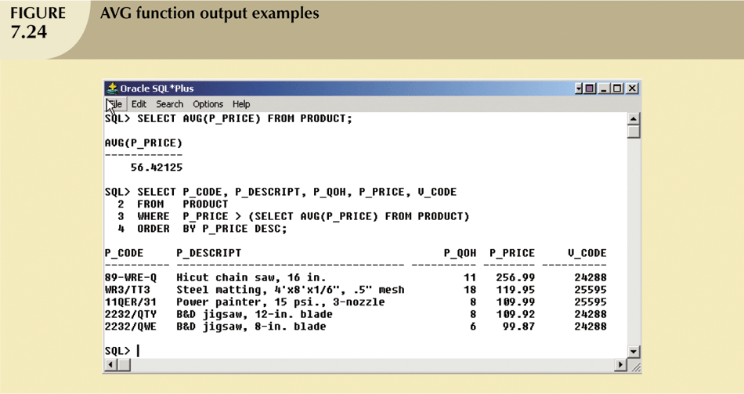
Aggregate Functions (continued)

Slide 25
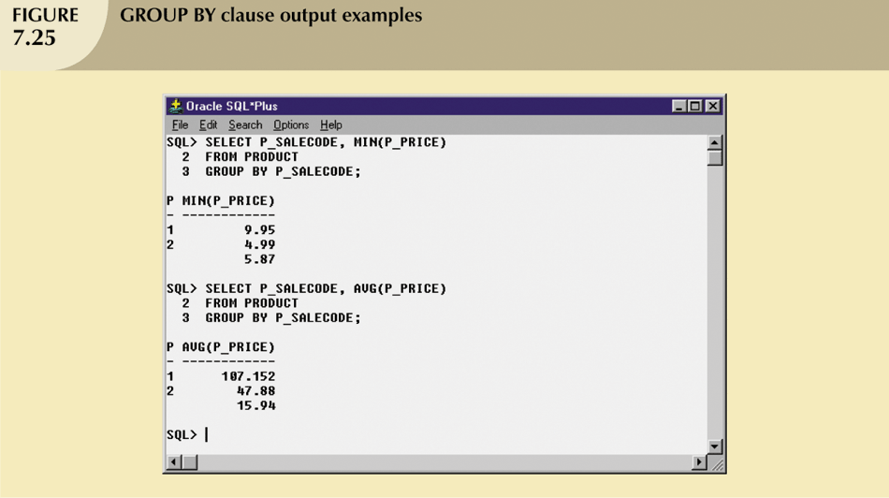
Grouping Data

Slide 26
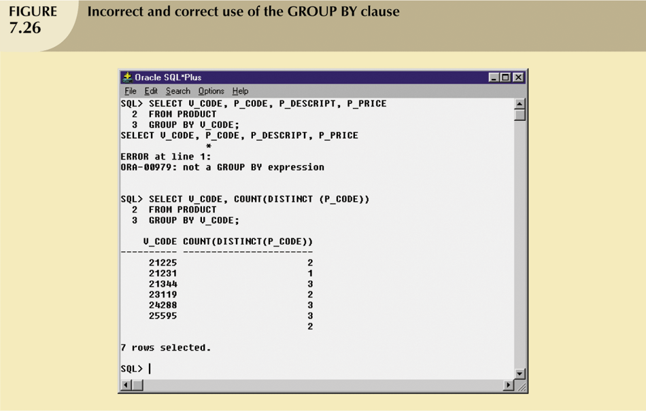
Grouping Data (continued)

Slide 27
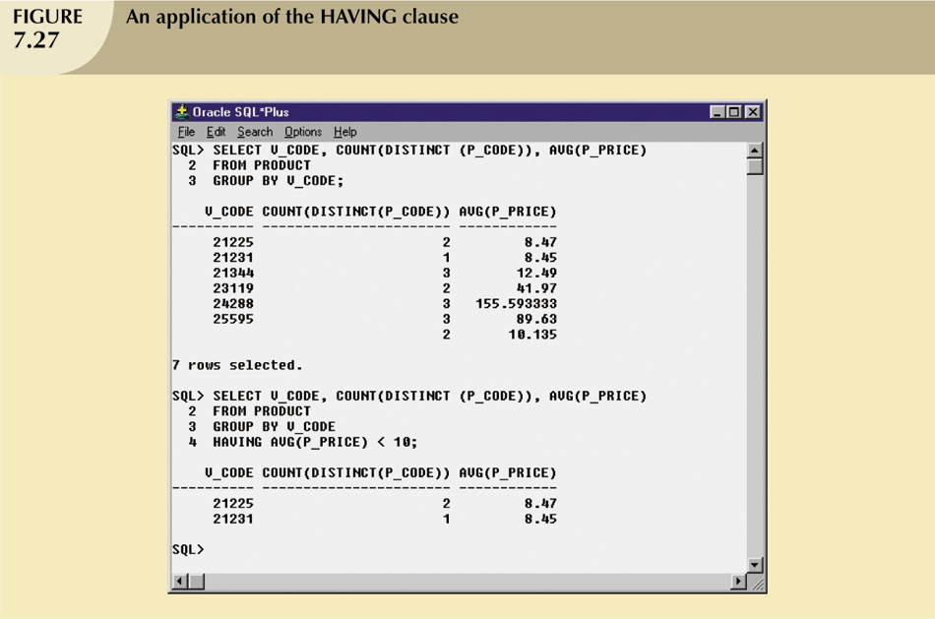
Grouping Data (continued)

Slide 28
Virtual Tables: Creating a View
View is virtual table based on SELECT query
Can contain columns, computed columns, aliases, and aggregate functions from one or more tables
Base tables are tables on which view is based
Create view by using CREATE VIEW command

Slide 29
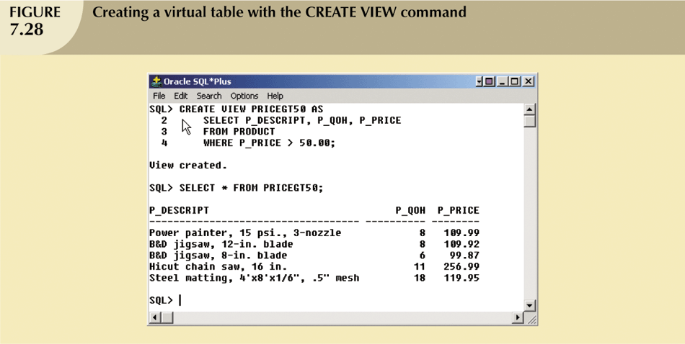
Virtual Tables: Creating a View (continued)

Slide 30
Joining Database Tables
Ability to combine (join) tables on common attributes is most important distinction between relational database and other databases
Join is performed when data are retrieved from more than one table at a time
Join is generally composed of an equality comparison between foreign key and primary key of related tables

Slide 31
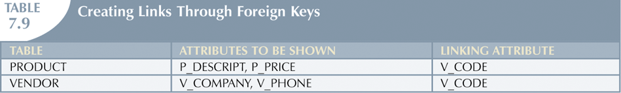
Joining Database Tables (continued)

Slide 32
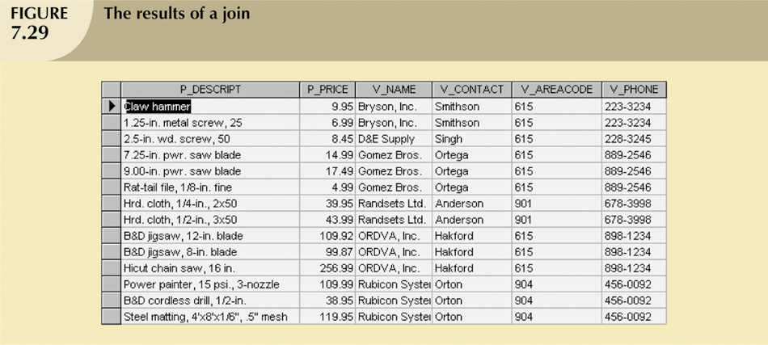
Joining Database Tables (continued)

Slide 33
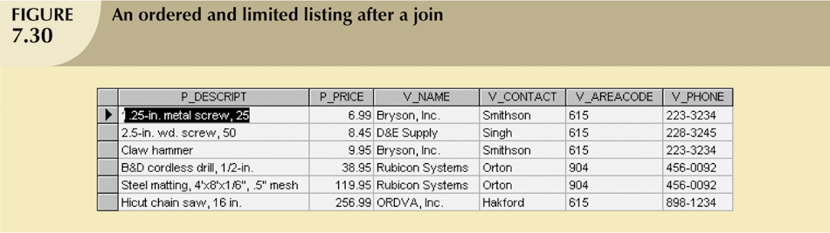
Joining Database Tables (continued)

Slide 34
Joining Tables with an Alias
Alias can be used to identify source table
Any legal table name can be used as alias
Add alias after table name in FROM clause
FROM tablename alias

Slide 35
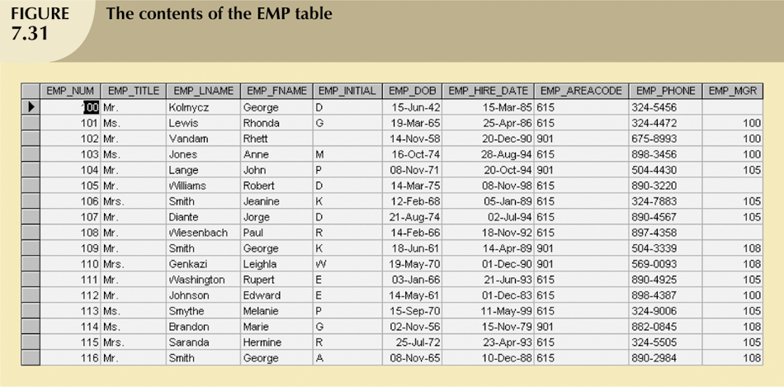
Recursive Joins

Slide 36
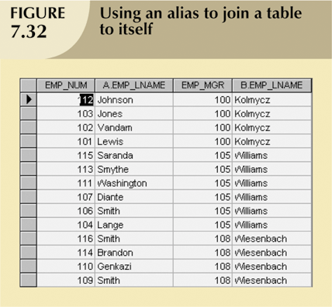
Recursive Joins (continued)

Slide 37
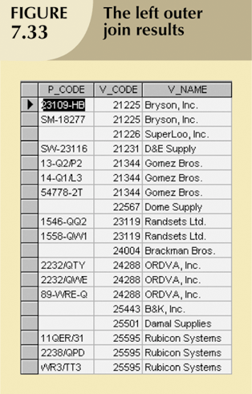
Outer Joins

Slide 38
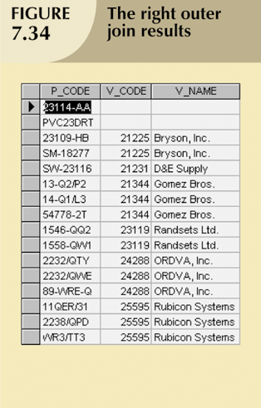
Outer Joins (continued)

Slide 39
Quick Review Question
State the difference between types of JOIN below
Inner join
Left join
Right join
Full join

Slide 40
Summary of Main Teaching Points
Aggregate functions
Special functions that perform arithmetic computations over a set of rows
ORDER BY clause
Used to sort output of SELECT statement
Can sort by one or more columns and use either an ascending or descending order
Join output of multiple tables with SELECT statement
Natural join uses join condition to match only rows with equal values in specified columns
Right outer join and left outer join used to select rows that have no matching values in other related table

Slide 41
Question and Answer Session
Q & A

Slide 42
What we will cover next
Degrees of data abstraction
Extended Entity Relationship Model

